Slide 1
Boston Code Camp 27 Data Science and Machine Learning Essentials
Andrew Babiec @ababiec
2017-03-25
Notes:
https://www.bostoncodecamp.com/CC27

Slide 2


















Boston Code Camp 27 - Thanks to our Sponsors!
Platinum
Gold
Silver
Bronze
In-Kind Donations

Slide 3
Have you ever wondered…
How does Facebook recognize faces in photos?
Why does speech recognition or language translation improve with more data samples?
How Netflix was able to improve their movie recommendations?
Image searches (and filtering) on google/bing

Slide 4
What is Machine Learning ?
Using known data, develop a model to predict unknown data.
Notes:
Basic definition:
Machine learning develops algorithms for making predictions (statistical sense) from data *
Learning models from available training data, to make good predictions on unseen test data

Slide 5
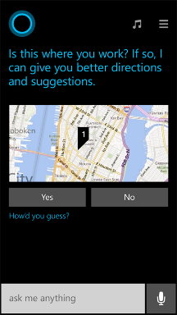
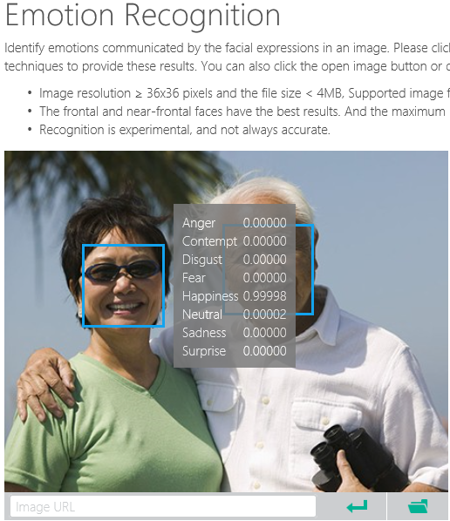
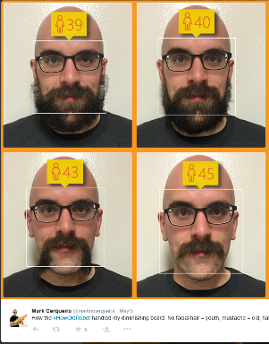
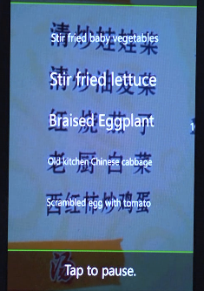
Why Machine Learning?
Notes:
Smart applications, services, platforms…
Digital Smart Personal Assistant
Image / Text / Data analyze

Slide 6
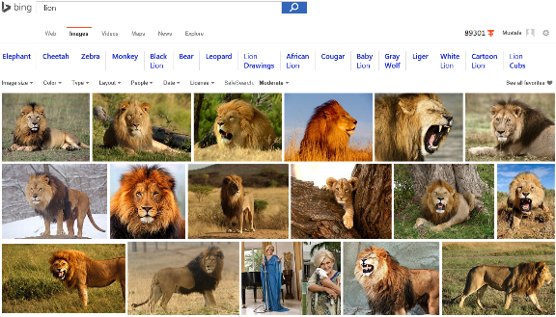
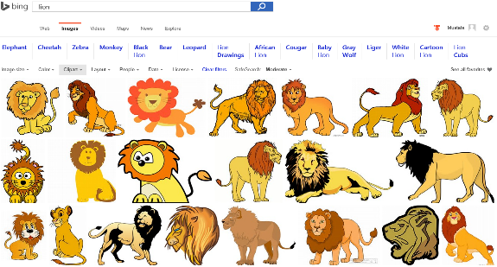
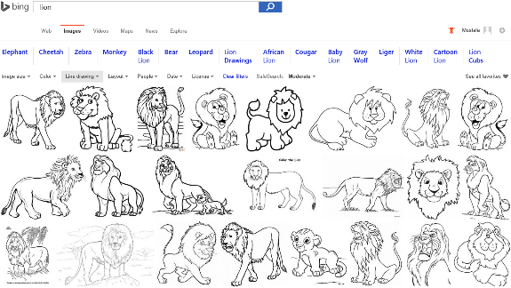
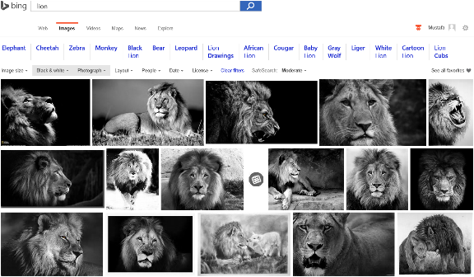
Image Analysis
Notes:
Search “lions” on Bing and change Image type etc. filters…
Behind the ML service categorizes the image db and returns the result.

Slide 7

Accent Color: Which border color is the best?
Notes:
Some another application on computer vision that meets with the machine learning

Slide 8
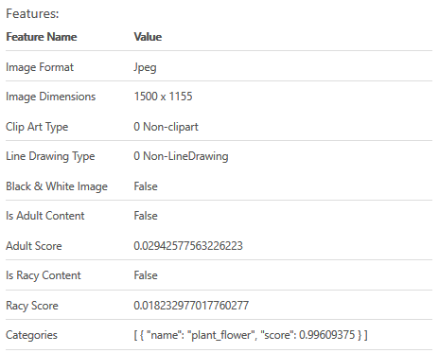

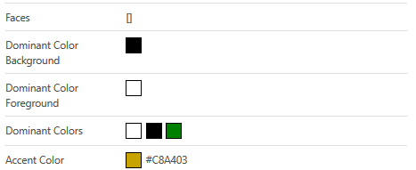
Accent Color: Analyze Image
Notes:
Goto https://www.projectoxford.ai/demo/visions#Analysis and analyze this image to find its accent color

Slide 9
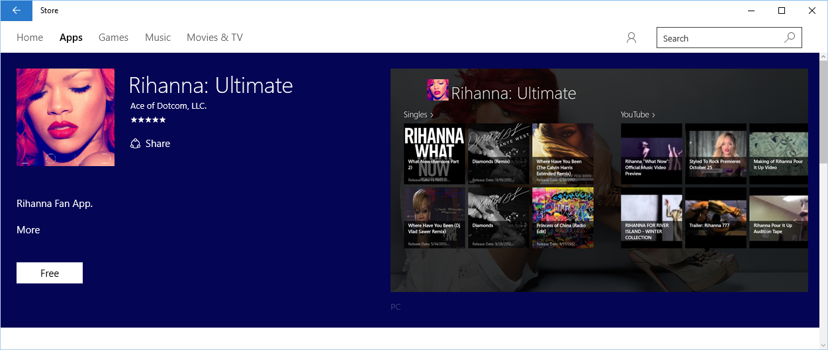
Accent Color: Windows 10 Store
Notes:
How to use accent color, case study.

Slide 10
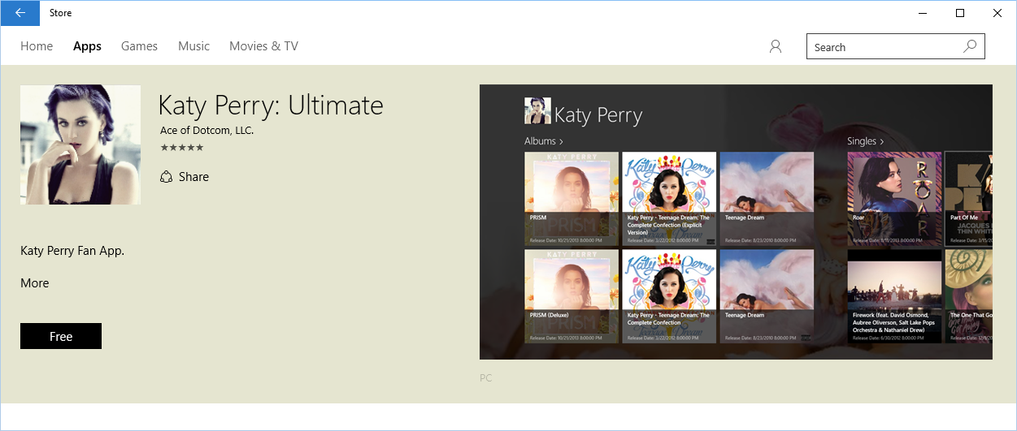
Accent Color: Windows 10 Store
Notes:
How to use accent color, case study.

Slide 11
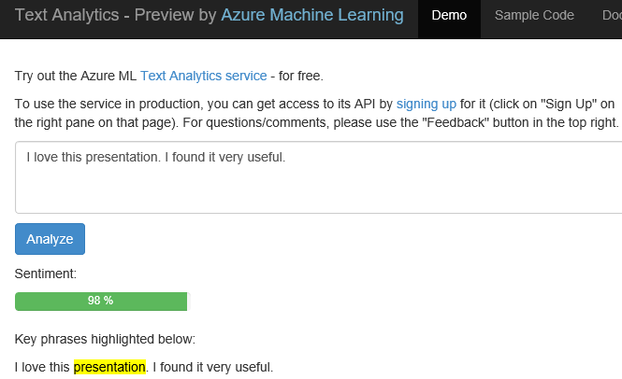
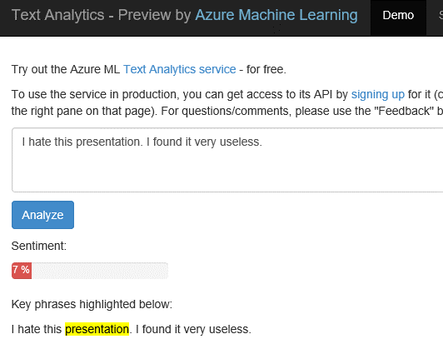
Text Analytics: User reviews
Positive
Negative
Notes:
Ready to use ML API published on Azure Datamarket place. A showcase of production ML solution in action (This can be used i.e. in shopping websites to see user reviews about a product etc.)
Test by yourself some of the reviews comments on Expedia or other online shopping sites. Copy/paste user comments to see the analyze result. If sentiment result shows higher percentage number, it means it is positive. If the percentage is low than it is a negative comment.
https://text-analytics-demo.azurewebsites.net/

Slide 12
What is data science
Evolving subject, no single definition
Requires a range of skills
Data science is the exploration and quantitative analysis of all available structured and unstructured data to develop understanding, extract knowledge, and formulate actionable results.

Slide 13
Data -> decisions -> actions
Data
What should I do?
Decision
Action
Decision automation
Decision support
What will happen?
Why did it happen?
What happened?
Manual process
Value

Slide 14
What Type of Analytics?
Retrospective
analytics
Real-time analytics
Predictive analytics
Intelligent
SaaS apps
Retrospective
analytics

Slide 15

Example use cases
Finance and risk
Sales and marketing
Customer and channel
Operations and workforce
Revenue Forecasting
Sales forecasting
User segmentation
Agent allocation
$$$
Portfolio optimization
Demand forecasting
Personalized offers
Warehouse efficiency
Investment modelling
Sales lead scoring
Product recommendation
Smart buildings
$$$
Fraud detection
Marketing mix optimization
Predictive maintenance
Risk management
Supply chain optimization
Notes:
Confidential…
+ notes From the book: AzureMachineLearning – AzureFundamentals
Many examples of predictive analytics can be found literally everywhere today in our society:
Spam/junk email filters These are based on the content, headers, origins, and even user behaviors (for example, always delete emails from this sender).
Mortgage applications Typically, your mortgage loan and credit worthiness is determined by advanced predictive analytic algorithm engines.
Various forms of pattern recognition These include optical character recognition (OCR) for routing your daily postal mail, speech recognition on your smart phone, and even facial recognition for advanced security systems.
Life insurance Examples include calculating mortality rates, life expectancy, premiums, and payouts.
Medical insurance Insurers attempt to determine future medical expenses based on historical medical claims and similar patient backgrounds.
Liability/property insurance Companies can analyze coverage risks for automobile and home owners based on demographics.
Credit card fraud detection This process is based on usage and activity patterns. In the past year, the number of credit card transactions has topped 1 billion. The popularity of contactless payments via near-field communications (NFC) has also increased dramatically over the past year due to smart phone integration.
Airline flights Airlines calculate fees, schedules, and revenues based on prior air travel patterns and flight data.
Web search page results Predictive analytics help determine which ads, recommendations, and display sequences to render on the page.
Predictive maintenance This is used with almost everything we can monitor: planes, trains, elevators, cars, and yes, even data centers.
Health care Predictive analytics are in widespread use to help determine patient outcomes and future care based on historical data and pattern matching across similar patient data sets.

Slide 16
Predictive vs Prescriptive Analysis
Predictive analytics calibrated on past data, tells us what to expect
Prescriptive analysis tells what actions to take

Slide 17
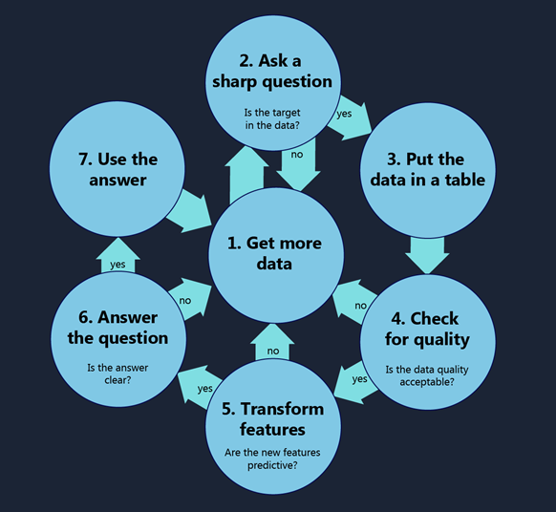
Data Scientists Are Obsessed with Data
Finding data sources
Acquiring data
Cleaning and transforming data
Understanding relationships in data
Delivering value from data
Notes:
https://blogs.technet.microsoft.com/machinelearning/2016/03/28/how-to-do-data-science/

Slide 18
Confusion
Statistics
Develops methods|models that explains data
Data Mining
Find previously unknown schema, patterns in data
Artificial Intelligence
Procedure of programing a computer to behave intelligent
Predictive Analytics
Using Machine Learning techniques to predict future

Slide 19
Steps to Build a Machine Learning Solution
1
Problem Framing
2 Get/Prepare Data
3
Develop Model
4
Deploy Model
5
Evaluate / Track Performance
3.1
Analysis/ Metric definition
3.2
Feature Engineering
3.3
Model Training
3.4
Parameter Tuning
3.5
Evaluation

Slide 20
Process – CCC Big Data Pipeline
CCC Big Data Pipeline from 2012*
Acquisition / Recording
Extraction /
Cleaning
/ Annotation
Integration
/
Aggregation
/ Representation
Analysis
/
Modeling
Interpretation
Heterogeneity
Scale
Timeliness
Privacy
Human Collaboration
Overall System
*From the Computing Community Consortium Big Data Whitepaper: http://www.cra.org/ccc/files/docs/init/bigdatawhitepaper.pdf
Notes:
Term “Big Data” coined by astronomers Cox and Ellsworth in 1997
Let’s start with historical notes. *Read* So it’s actually kind of an old term that got a bit hyped up a few years ago after the CCC whitepapers on Big Data came out. I’m showing you the CCC big data pipeline from the whitepaper in 2012. It’s nice, it’s an effort to formalize the scientific process that goes into discovering knowledge from data. It’s not just data mining, there’s a lot more to it. In fact, data mining is the 4th step out of 5. Major steps in analysis of big data are shown in the flow at the top. Below it are big data needs that make these tasks challenging. Let me go through the 5 steps.
First you have to go through a process of actually obtaining the data. Perhaps that involves recording how users behave on different websites, so you have to write a script to collect the data properly.
The second step is extraction/cleaning/annotation, where you try to reduce the noise a bit and get rid of the data you don’t directly need. Or if you’re working with free text that’s easy to annotate, you might be able to turn it into a structured table. Basically at this step, you’re turning the data from what is potentially a pile of rubbish into something you might actually be able to work with.
At the third step you are going to set up the data in a way that is directly conducive to data mining. All the text documents are linke properly to the other structured tables, and you have one central database where the information is stored neatly.
:
Ok so that’s the big data pipeline. Now I’m going to show you another, separate big data pipeline, constructed by a separate group of people, at another time. So this is a second group of people trying to formalize the discovery of knowledge from data. Ready?

Slide 21
Process - KDD (Knowledge Discovery in Databases)
Interpretation / Evaluation
Data Mining
Transformation
Preprocessing
Information
Patterns
Selection
Transformed Data
Preprocessed Data
Target Data
Data
Based on content in “From Data Mining to Knowledge Discovery”, AI Magazine, Vol 17, No. 3 (1996)
http://www.aaai.org/ojs/index.php/aimagazine/article/view/1230
Notes:
Selection, preprocessing, transformation.
Does it look familiar? It should, because it’s the same as on the previous slide! Same exact steps. So you’re probably not surprised, so what, two groups came up with the same diagram. But look. This diagram is from 1996.
Way before the CCC had “big data” as a twinkling in their eyes. And the CCC people did not cite the original KDD paper – they didn’t know about each other. Perhaps there is something fundmental here about this process. Maybe it’s like an important number, like pi or the golden ratio or something. This sort of universal process that people separately discover. Anyway, so this is the kdd process.

Slide 22
Process - CRoss Industry Standard Process for Data Mining (CRISP-DM)
Business Understanding
Data Understanding
Data Preparation
Modeling
Evaluation
Deployment
Identify project objectives
Collect and review data
Select and cleanse data
Manipulate data and draw conclusions
Evaluate model and conclusions
Apply conclusions to business
From 2000, 77 pages
Notes:
Now, KDD wasn’t the only game in town before the CCC whitepapers. This is CRISP-DM – Cross.... These guys were really serious about formalizing the process. They wrote a 77 page manual on how to do this stuff. I actually like CRISP-DMs process the best, because it includes business understanding and data understanding. I also love all the backwards arrows showing how many iterations you do within this process on a regular basis. Anyway, this is the process I tend to think of.

Slide 23
Stages in the knowledge discovery process
Opportunity Assessment & Business Understanding
Data Understanding & Data Acquisition
Data Cleaning and Transformation
Model Building
Policy Construction
Evaluation, Residuals and Metrics
Model Deployment, Monitoring, Model Updates
Notes:
these are essentially taken from CRISP-DM.

Slide 24
Opportunity Assessment & Business Understanding
What do you really want to accomplish and what are the constraints?
What are the risks?
How will you evaluate the quality of the results?
Notes:
*read* These goals are concrete – we can form concrete assessments of how well we did with these tasks.
For manhole events the general goal was to “predict manhole fires and explosions before they occur.” We made it more precise:
Goal 1: Assess predictive accuracy for predicting manhole events in the year before they happen.
Goal 2: Create a cost-benefit analysis for inspection policies that takes into account the cost of inspections and manhole fires. Determine how often manholes need to be inspected.

Slide 25
Data Understanding & Data Acquisition
Examples of data sources for NYC manhole study:
Trouble tickets – free text documents typed by dispatchers documenting problems on the electrical grid.
Records of information about manholes
Records of information about underground cables
Electrical shock information tables
Extra information about serious events
Inspection reports
Vented cover data
How do you know what data to trust?
V’s of Big Data include “Variety” and “Veracity”
Notes:
Cables were not matched to manholes
What data to trust?
You don’t. Over half of our information was useless. We didn’t know which half. This ties into the evaluation – if you don’t know which data to trust, how are you going to evaluate the quality of the results? Those are the kinds of problems we were stuck on. It wasn’t the ML that was the hard part here. Most of the time the ML isn’t the hard part. If you’re taking this class, probably ML is maybe a little intimidating, but that’s not the part you should be intimidated by. Hopefully this class will help you in that respect.

Slide 26
Data Cleaning and Transformation
Turn free text into structured information
Try to integrate tables (create unique identifiers)
Sometimes 99% of the work
Notes:
Before this step you might have a giant pile of garbage.
Trouble tickets turned into a vector like:
Serious / Less Serious / Not an Event
Year
Month
Day
Manholes involved
…

Slide 27
Model Building
Often predictive modeling, meaning machine learning or statistical modeling
If you want to answer a yes/no question, this is classification.
For manholes, will the manhole explode next year? Y/N
If you want to predict a numerical value, this is regression.
If you want to group observations into similar-looking groups, this is clustering.
If you want to recommend someone an item (e.g., book/movie/product) based on ratings data from customers, this is a recommender system.
Note: There are many other machine learning problems.
Notes:
Predictive doesn’t necessarily mean in the future time-wise. It could mean prediction of a new circumstance you haven’t seen before.

Slide 28
Policy Construction
How will your model be used to change policy?
E.g., for manholes, how should we recommend changing the inspection policy based on our model?
E.g., consider using social media and customer purchase data to determine customer participation if Starbucks moves into New City. Once the model is created, how to optimize where the shops are located, how big they are, and where the warehouses are located.
Model building is predictive, Policy Construction is prescriptive.

Slide 29
Evaluation
How do you measure the quality of the result? Evaluation can be difficult if the data do not provide ground truth.
- For manhole events, engineers at Con Edison withheld high quality recent data and conduct a blind test.
Notes:
That’s how they knew they could trust us.

Slide 30
Deployment
Getting a working proof of concept deployed stops 95% percent of projects.
Don’t bother doing the project in the first place if no one plans to deploy it.*
Keep a realistic timeline in mind. Then add several months.
While the model is deployed it will need to be updated and improved.
* Unless it’s fun.
Notes:
It’s like “Hey I turned lead into gold” and the reaction is “well, that’s nice”
Goals might change, data itself might change, data might change as a reaction to the new policy, you observe something that you didn’t expect and need to put it in, etc.

Slide 31
Machine Learning
Grew out of artificial intelligence within computer science. Teaches computers by example.
ML is arguably part of statistics.
Is this a chair?
Notes:
Machine learning as a field, *read*
If we want to teach the computer to recognize images of chairs, then we give the computer a whole bunch of images, and tell it which ones are chairs and which are now, and then it’s supposed to learn to recognize chairs, even ones it hasn’t seen before. It’s not like we tell the computer how to recognize a chair, we don’t tell it “a chair has 4 legs and a back and a flat surface to sit on and so on”, we just give it a lot of examples.
Machine learning has close ties to statistics, in fact it’s hard to say what’s different about predictive statistics and machine learning, and these fields are very closely linked right now.

Slide 32

Classification
We have a training set of observations (e.g., labeled images) and a test set that we use only for evaluation.
Training set
Test set
(not a chair)
(chair)
(not a chair)
(chair)
(not a chair)
(not a chair)
(not a chair)
(not a chair)
Notes:
The problem I just told you about is a classification problem where we are trying to identify chairs. The way we set the problem up is that we have a *read*
We use the training set to learn a model of what a chair is. The test set are images that are not in the training set, and we want to be able to make predictions on those, as to whether or not each image is a chair.
It could be that some the labels on the training set are noisy. That could happen. In fact one if these labels is noisy *point*. That’s ok, because as long as their isn’t too much noise, we should still be able to learn a model for a chair. It just won’t be able to classify perfectly, and that happens. Some prediction problems are harder than others, but that’s ok, we just do the best we can from the training data. And in terms of the size of the training data, the more the merrier. We want as much data as we can to train these models.

Slide 33
Classification
Each observation is represented by a set of numbers (features).
NYC manhole represented as: [ 5 3 120 12 1 0 ….. ]
Inspected?
Vented cover?
Number of events last year
Number of electrical cables
Number of serious events last year
Number of pre-1930 electrical cables
Notes:
Here’s another example. This is a problem that comes from NYC’s power company, where they wanted to predict which manholes were going to have a fire. So we would represent each manhole as a vector, and here are the components in the vector. The first component might be *read*.
In general, the first step is to figure out how to represent your data as a vector. You can make the vector very large, you can include lots of factors if you like, that’s fine. Computationally things are easier if you use fewer features, but then you risk leaving out information. So there’s a tradeoff right there that you will have to worry about, and we’ll talk more about that later. But in any case, you can’t do ML if you don’t have your data represented this way, so that’s the first step. *pause*
You’d think that manholes with more cables, more recent serious events, etc. would be more prone to explosions and fires in the future. But what combination of them would give you the best predictor? How do you combine them together? You could add them all up but that might not be the best thing. You could give them all weights and add them up, but how do you know the weights? That’s what ML does for you. It tells you what combinations to use to get the best predictors.

Slide 34
Classification
Each observation is represented by a set of numbers (features).
Manhole is represented as: [ 5 3 120 12 1 0 ….. ] -1
[ 0 0 89 5 1 1 ….. ] 1
[ 1 0 20 0 0 1 ….. ] -1
Features, called X
Labels, called Y
(Predictors, Covariates, Explanatory Variables, Independent Variables)
Notes:
Just to be formal about it, *Read*
The features are also called *read* so you can choose whatever terminology you like.

Slide 35
Classification
Yes/No questions is the most basic
Uses: automatic handwriting recognition, speech recognition, biometrics, document classification, spam detection, predicting credit default risk, detecting credit card fraud, predicting customer churn, predicting medical outcomes (strokes, side effects, etc.)

Slide 36
Multi-class classification
If you can solve binary classification, you can solve multiclass classification.
There are specialized algorithms, but the simplest is to do “1 vs all”.
Create a classifier to predict each class separately
Choose the classifier with the strongest “confidence” in the class
X (chair, tomato, bird, pepper,…)
Notes:
*read*
Here you want a function that given a new x, predicts which of possibly many classes x best fits into. So here, if X is an image, we want to know if X is an image of a chair, a tomato, and bird, a green pepper, and so on. Now there are specialized algorithms for multiclass classification, but the simplest things to do is called 1 vs all. To do 1 vs all, you just take your favorite classification algorithm, and you create a binary classification problem for each class. So we’d create a separate classifier for chair/not chair, … and we’ll use *those* classifiers to get us the solution to the multiclass problem. Since our classifiers have a value of f(x), we can use it as a sort of confidence measure for the prediction. So if you have an image of a chair, the “chair” classifier would say “I’m absolutely certain that this image is a chair by giving a large positive value of f(x)”. Chances are that the chair classifier would be the most certain about classifying the image, which would tell us to trust that classifier. There are other ways to do multiclass classification than 1 vs all, but I wanted to explain to you how being able to solve a regular classification problem can directly get you the solution to a multiclass problem.

Slide 37
Regression
For predicting real-valued outcomes:
How many customers will arrive at our website next week?
How many products will we sell next year?
Can we predict someone’s income from their click through information?
Notes:
Supervised regression = regression

Slide 38
Regression
Each observation is represented by a set of numbers.
Income
A person is represented as: [ 5 3 120 12 1 0 ….. ] 84
[ 0 0 89 5 1 1 ….. ] 32
[ 1 0 20 0 0 1 ….. ] -10
Features, called X
Labels, called Y

Slide 39
Regression
Formally, given training set (x_{i,}y_{i}) for i=1…n, we want to create a regression model f that can predict label y for a new x.
EXAMPLE: Estimated income
f(x) = function(Number of visits to upscale furniture websites, Number of Businessweek clicks, Number of distinct people emailed per day, Number of purchases of over 5K within the last month, Number of visits to airlines, etc.)
For instance,
f(x) = 3*Number of visits to upscale furniture websites
+10*Number of Businessweek clicks
+100*Number of distinct people emailed per day
+2*Number of purchases of over 5K within the last month
+10*Number of visits to airlines
But f(x) could be much more complicated

Slide 40
Regression
We want to create a regression model f that can predict label y for a new x.
1,000K
Training Data
EXAMPLE: Estimated income
f(x) = function(Number of Businessweek clicks)
y = Income
f(x)
Income
0
2000
0
Number of Businessweek clicks

Slide 41
Regression
We want to create a regression model f that can predict label y for a new x.
1,000K
f(x) = function(Number of Businessweek clicks)
f(x)
Income
(Overfitting?)
0
2000
0
Number of Businessweek clicks

Slide 42
Regression
We want to create a regression model f that can predict label y for a new x.
1,000K
f(x) = function(Number of Businessweek clicks)
= 5K*Number of Businessweek clicks + 10K
f(x)
Income
(Underfitting?)
0
2000
0
Number of Businessweek clicks

Slide 43
Regression
We want to create a regression model f that can predict label y for a new x.
1,000K
f(x) = function(Number of Businessweek clicks)
f(x)
Income
(Just right?)
0
2000
0
Number of Businessweek clicks

Slide 44
Statistical Learning Theory
The best models are simple models that fit the data well.
We need a balance between accuracy and simplicity.
1,000K
f(x)
Income
0
2000
0
Number of Businessweek clicks

Slide 45
But I’m not good at math! How will I create f() ?
The machine learning algorithm you select will create the function f for you. It might be very complicated, but the way to use is is not complicated

Slide 46
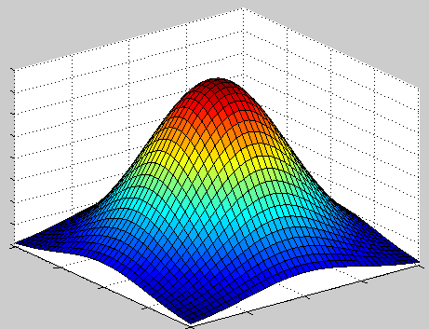
Algorithms
Linear Regression
Logistic Regression
Support Vector Machine (SVM)
Boosting
Decision Tree
Neural network

Slide 47
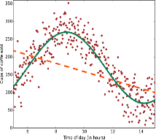
Regression
Scenarios:
Stock prices prediction
Sales forecasts
Premiums on insurance based on different factors
Quality control: number of complaints over time based on product specs, utilization, etc.
Workforce prediction
Workload prediction
Algorithms: Bayesian Linear, Linear Regression, Ordinal Regression, ANN, Boosted Decision Tree, Decision Forest
Regression

Slide 48
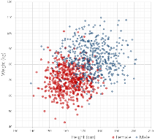
Classification
Scenarios:
Which customer are more likely to buy, stay, leave (churn analysis)
Which transactions/actions are fraudulent
Which quotes are more likely to become orders
Recognition of patterns: speech, speaker, image, movement, etc.
Algorithms: Boosted Decision Tree, Decision Forest, Decision Jungle, Logistic Regression, SVM, ANN, etc.
Classification

Slide 49
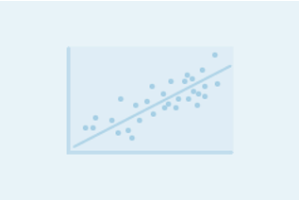
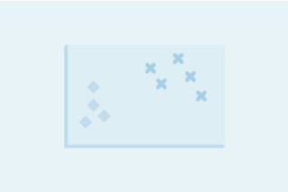
Regression versus Classification
Does your customer want to predict/estimate a number (regression) or apply a label/categorize (classification)?
Regression problems
Estimate household power consumption
Estimate customer’s income
Classification problems
Power station will|will not meet demand
Customer will respond to advertising

Slide 50
Model (Decision Tree)
Age<30
Income > $50K
Xbox-One Customer
Not Xbox-One Customer
Days Played > 728
Income > $50K
Xbox-One Customer
Not Xbox-One Customer
Xbox-One Customer
Notes:
More samples on: https://azure.microsoft.com/en-us/documentation/articles/machine-learning-algorithm-choice/

Slide 51
Decision Trees
age≤30
age>30
#classes>8
#classes≤8
Bschool
No Bschool
laundry
No laundry
Male
Female
Predict y=-1
Predict y=-1
Predict y=-1
Predict y=1
Predict y=1
Predict y=1
Predict y=1
Predict y=-1

Slide 52
Imbalanced Data
Many classification algorithms produce garbage when the data are highly imbalanced (e.g, decision trees).
Do not use classification accuracy (if 99% negative examples, a model that always predicts negative is 99% accurate).
Instead use true positive rate and false positive rate.
One trick is to oversample the minority class so that the data looks more balanced than it really is.
Another trick is to weight mistakes on the minority class more highly.

Slide 53
False Positive Rate (FPR) and True Positive Rate (TPR)
FPR = number of negatives that were classified by the ML algorithm as positives / total number of negatives
TPR = number of positives that were classified by the ML algorithm as positives / total number of positives

Slide 54
Cross-Validation
I tried ridge regression and I tried SVM regression, how do I know which one performed better?

Slide 55
Cross-Validation
Cross Validation (CV) is the most popular way to evaluate a machine learning algorithm on a dataset.
You will need a dataset, an algorithm, and an evaluation measure for the quality of the result. The evaluation measure might be the squared error between the predictions and the truth.
Divide the data into approximately-equally sized 10 “folds”
Train the algorithm on 9 folds, compute the evaluation measure on the last fold.
Repeat this 10 times, using each fold in turn as the test fold.
Report the mean and standard deviation of the evaluation measure over the 10 folds.

Slide 56
Cross-Validation
Cross Validation (CV) is the most popular way to evaluate a machine learning algorithm on a dataset.
You will need a dataset, an algorithm, and an evaluation measure for the quality of the result. The evaluation measure might be the squared error between the predictions and the truth.
Divide the data into approximately-equally sized 10 “folds”
Train the algorithm on 9 folds, compute the evaluation measure on the last fold.
Repeat this 10 times, using each fold in turn as the test fold.
Report the mean and standard deviation of the evaluation measure over the 10 folds.
Train
Test

Slide 57
Cross-Validation
Cross Validation (CV) is the most popular way to evaluate a machine learning algorithm on a dataset.
You will need a dataset, an algorithm, and an evaluation measure for the quality of the result. The evaluation measure might be the squared error between the predictions and the truth.
Divide the data into approximately-equally sized 10 “folds”
Train the algorithm on 9 folds, compute the evaluation measure on the last fold.
Repeat this 10 times, using each fold in turn as the test fold.
Report the mean and standard deviation of the evaluation measure over the 10 folds.
Test
Train

Slide 58
Cross-Validation
Cross Validation (CV) is the most popular way to evaluate a machine learning algorithm on a dataset.
You will need a dataset, an algorithm, and an evaluation measure for the quality of the result. The evaluation measure might be the squared error between the predictions and the truth.
Divide the data into approximately-equally sized 10 “folds”
Train the algorithm on 9 folds, compute the evaluation measure on the last fold.
Repeat this 10 times, using each fold in turn as the test fold.
Report the mean and standard deviation of the evaluation measure over the 10 folds.
Test

Slide 59
Cross-Validation
Cross Validation (CV) is the most popular way to evaluate a machine learning algorithm on a dataset.
You will need a dataset, an algorithm, and an evaluation measure for the quality of the result. The evaluation measure might be the squared error between the predictions and the truth.
Divide the data into approximately-equally sized 10 “folds”
Train the algorithm on 9 folds, compute the evaluation measure on the last fold.
Repeat this 10 times, using each fold in turn as the test fold.
Report the mean and standard deviation of the evaluation measure over the 10 folds.
Test

Slide 60
Cross-Validation
The algorithm that performed the best was the one with the best average out-of-sample performance across the 10 test folds.
If desired, compute significance tests on performance across folds.

Slide 61
Supervised Learning
Classification and Regression are supervised learning problems.
“Supervised” means that the training data has ground truth labels to learn from.
(Supervised) classification often has +1 or -1 labels.
(Supervised) regression has numerical labels.
There are lots of other supervised problems.
Supervised learning algorithms are much easier to evaluate than unsupervised ones.

Slide 62
Unsupervised Learning
“Unsupervised” means that the training data has no ground truth labels to learn from.
Supervised:
(chair)
(not a chair)
(not a chair)
chair?
(chair)
(not a chair)
(chair)
(not a chair)

Slide 63
Unsupervised Learning
“Unsupervised” means that the training data has no ground truth labels to learn from.
Unsupervised:

Slide 64
Unsupervised Learning
“Unsupervised” means that the training data has no ground truth labels to learn from.
This means they are much harder to evaluate.
Clustering is an key unsupervised problem.

Slide 65
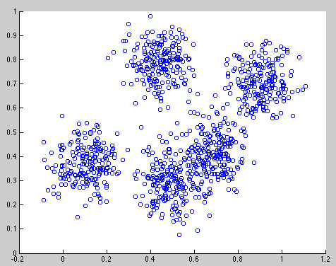
Clustering
Data within a cluster should be similar to other members of the cluster.
Notes:
jellyroll

Slide 66
Clustering
Data within a cluster should be similar to other members of the cluster.
Notes:
jellyroll

Slide 67
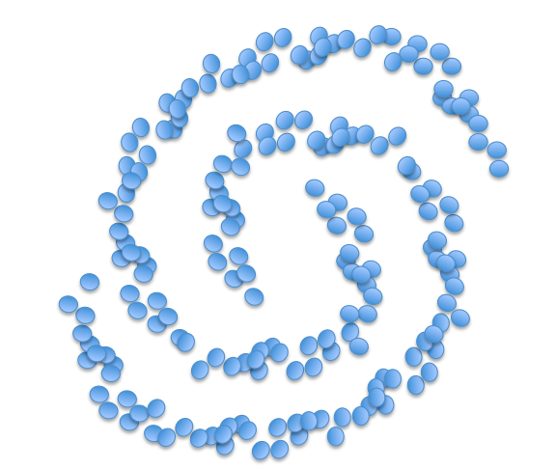
Clustering
Data within a cluster should be similar to other members of the cluster.
Notes:
jellyroll

Slide 68
Clustering
Applications include:
Automatically grouping documents/webpages into topics
For instance, grouping news stories from today into categories
Clustering large number of products
E.g., etsy products
Clustering customers into those with similar purchase behavior
Notes:
jellyroll

Slide 69
Clustering
Tricky to evaluate the quality of a clustering. No ground truth.
One way to test algorithms is to generate the data according to a simulation, so we know ground truth. We can determine whether the clustering algorithm can recover the underlying clusters.

Slide 70
K Means Clustering
Input number of clusters, randomly initialize centers
Assign all points to the closest cluster center
Change cluster centers to be in the middle of its points
Repeat until convergence

Slide 71
K-Means in action
Input number of clusters, randomly initialize centers
Assign all points to the closest cluster center
Change cluster centers to be in the middle of its points
Repeat until convergence

Slide 72
K-Means in action
Input number of clusters, randomly initialize centers
Assign all points to the closest cluster center
Change cluster centers to be in the middle of its points
Repeat until convergence

Slide 73
K-Means in action
Input number of clusters, randomly initialize centers
Assign all points to the closest cluster center
Change cluster centers to be in the middle of its points
Repeat until convergence

Slide 74
K-Means in action
Input number of clusters, randomly initialize centers
Assign all points to the closest cluster center
Change cluster centers to be in the middle of its points
Repeat until convergence

Slide 75
K-Means in action
Input number of clusters, randomly initialize centers
Assign all points to the closest cluster center
Change cluster centers to be in the middle of its points
Repeat until convergence

Slide 76
Hierarchical Agglomerative Clustering
Start with each point in its own cluster
Repeatedly merge the clusters of the closest two points

Slide 77
Hierarchical Agglomerative Clustering
Start with each point in its own cluster
Repeatedly merge the clusters of the closest two points
Notes:
jellyroll

Slide 78
Hierarchical Agglomerative Clustering
Start with each point in its own cluster
Repeatedly merge the clusters of the closest two points
Notes:
jellyroll

Slide 79
Hierarchical Agglomerative Clustering
Start with each point in its own cluster
Repeatedly merge the clusters of the closest two points
Notes:
jellyroll

Slide 80
Hierarchical Agglomerative Clustering
Start with each point in its own cluster
Repeatedly merge the clusters of the closest two points
Notes:
jellyroll

Slide 81
Hierarchical Agglomerative Clustering
Start with each point in its own cluster
Repeatedly merge the clusters of the closest two points
Notes:
jellyroll

Slide 82
Hierarchical Agglomerative Clustering
Start with each point in its own cluster
Repeatedly merge the clusters of the closest two points
Notes:
jellyroll

Slide 83
Hierarchical Agglomerative Clustering
Start with each point in its own cluster
Repeatedly merge the clusters of the closest two points
Notes:
jellyroll

Slide 84
Hierarchical Agglomerative Clustering
Start with each point in its own cluster
Repeatedly merge the clusters of the closest two points
Notes:
jellyroll

Slide 85
Hierarchical Agglomerative Clustering
Start with each point in its own cluster
Repeatedly merge the clusters of the closest two points
Notes:
jellyroll

Slide 86
Hierarchical Agglomerative Clustering
Start with each point in its own cluster
Repeatedly merge the clusters of the closest two points
Notes:
jellyroll

Slide 87
Distance metrics are important
The distance measure used for clustering can have a large impact on the solution.
Some algorithms have “adaptive” distance measures that change with the density of the data.

Slide 88
Recommender Systems and Matrix Factorization
The Netflix contest: Build a better recommender system from Netflix data
A B C D
Carmen
Joseph
Leonore
Esmerelda
Use the crowd’s votes to complete the missing entries
Notes:
Let’s say you want to figure out what Joseph’s rating for movie C would be. How do you do it? Maybe use Carmen. Maybe C’s ratings were bad overall (not true here), so we think Joseph won’t like it.
This problem is supervised by the way. You can leave part of your data out and evaluate the quality of your algorithm on it.

Slide 89
Recommender Systems and Matrix Factorization
Option 1: User-Based Collaborative Filtering: Fill in Joseph’s score for Dark Knight using similar users’ ratings.
Dark Knight
Aliens
Bug’s Life
Cars
Carmen
Joseph
Leonore
Esmerelda
Notes:
need a measure to find similar users.

Slide 90
Recommender Systems and Matrix Factorization
Option 2: Item-Based Collaborative Filtering: Fill in Joseph’s score for Dark Knight using similar items’ ratings.
Dark Knight
Aliens
Bug’s Life
Cars
Carmen
Joseph
Leonore
Esmerelda

Slide 91
Matrix Factorization
Aliens
Dark Knight
Bug’s Life
Cars
Carmen
Notes:
Let’s start with Carmen’s ratings.

Slide 92
Matrix Factorization
Aliens
Dark Knight
Bug’s Life
Cars
Carmen
Scary
Kiddy
Carmen¹
Notes:
Carmen1 is the essence of Carmen. It’s actually who she really is. She likes scary movies and dislikes kiddy movies. So the fact that Aliens stars whatever actors it stars doesn’t really matter, she likes it because it’s scary. If you knew Carmen’s essence, you’d be able to figure out her ratings for Bug’s Life, which is a kiddy movie. Doesn’t matter how good of a kiddy movie Bug’s Life is, she just doesn’t like kiddy movies, so she’s going to give it a low rating most likely.

Slide 93
Matrix Factorization
Scary
Kiddy
Scary
Kiddy
Carmen¹
Dark Knight
Notes:
So, let’s take a movie like Dark Knight, which is about batman, but it’s for grownups, so it’s sort of half scary and half kiddy.

Slide 94
Matrix Factorization
Scary
Kiddy
Scary
Kiddy
Carmen¹
Dark Knight
My guess for Carmen’s rating on Dark Knight:
Notes:
So here’s my guess for Carmen’s rating, it’s sort of half way between what she’d say for a scary movie and for a kiddy movie.

Slide 95
Matrix Factorization
Aliens
Dark Knight
Bug’s Life
Cars
Carmen
Scary
Kiddy
Scary
Kiddy
Carmen¹
Dark Knight
My guess for Carmen’s rating on Dark Knight:
Notes:
Let’s put her actual ratings up that we had before and you can see that our guess agreed with how she actually rated it, which means that our values for Carmen1 might be pretty accurate. The nice thing is that if you have carmen1, then you can sort of figure out how Carmen is going to rate a lot of different movies, as long as you know whether they are scary or kiddy movies.

Slide 96
Matrix Factorization
Dark Knight
Aliens
Cars
Bug’s Life
Carmen
Scary
Kiddy
Scary
Kiddy
Carmen¹
Dark Knight
My guess for Carmen’s rating on Dark Knight:
Notes:
So you could guess her ratings for lots of different movies.
Doesn’t matter how many movies we’re considering, as long as we know the secret information, the essence of Carmen, then we can pretty much figure out what most of her ratings are going to look like

Slide 97
Recap - Machine Learning Algorithms
Two major category of algorithms
Supervised
Unsupervised
Most commonly used machine learning algorithms are supervised (requires labels)
Supervised learning examples
This customer will like coffee
This network traffic indicates a denial of service attack
Unsupervised learning examples
These customers are similar
This network traffic is unusual
Notes:
How to choose algorithms for Microsoft Azure Machine Learning
https://azure.microsoft.com/en-us/documentation/articles/machine-learning-algorithm-choice/

Slide 98
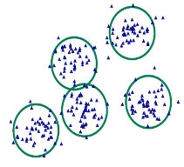
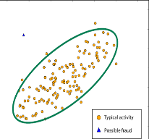
Common Classes of Algorithms (Supervised|Unsupervised)
Classification
Clustering
Regression
Anomaly Detection
Notes:
More samples on: https://azure.microsoft.com/en-us/documentation/articles/machine-learning-algorithm-choice/
Mention about Classification, Regression etc.

Slide 99
Why you need to know these algorithms?
If you want to answer a YES|NO question, it is classification
If you want to predict a numerical value, it is regression
If you want to group data into similar observations, it is clustering
If you want to recommend an item, it is recommender system
If you want to find anomalies in a group, it is anomaly detection
and many other ML algorithms for specific problem

Slide 100
Azure ML

Slide 101
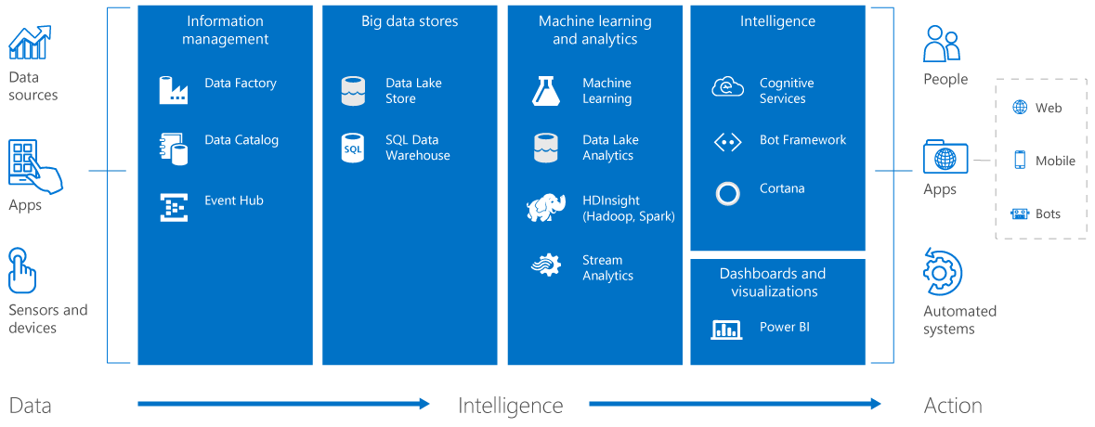
Cortana Intelligence Suite services
Notes:
https://azure.microsoft.com/en-us/suites/cortana-intelligence-suite/
Cognitive Services:
Speech API - Convert speech to text and back again to understand user intent
Translator Speech API - Easily conduct real-time speech translation with a simple REST API call
Spell Check API
Text Analytics API

Slide 102
Why Azure ML?
Quickly deploy production solutions as web services
Models run in a highly scalable cloud environment
Secure cloud environment for data and code
Powerful, efficient built-in algorithms
Extensible with, SQL, Python, and R

Slide 103
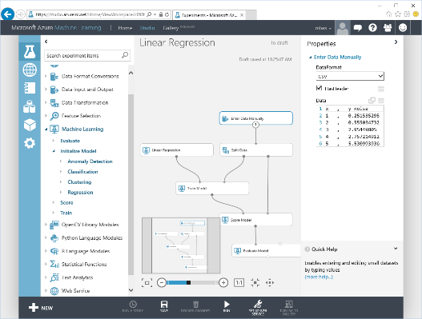
Microsoft Azure Machine Learning
Web based UI accessible from different browsers
Share|collaborate to any other ML workspace
Drag&Drop visual design|development
Wide range of ML Algorithms catalog
Extend with OSS R|Python scripts
Share|Document with IPython|Jupyter
Deploy|Publish|Scale rapidly (APIs)
Notes:
Lets look at some of the features of ML Studio

Slide 104
Why R and Python?
R and Python widely used in data science
Highly interactive
Good visualization
Vast packages (libraries) of utilities and algorithms
Excellent development environments

Slide 105
Azure Machine Learning Ecosystem
Provision Workspace
Build ML Model
Deploy as Web Service
Publish an App
Get/Prepare Data
Publish Web Service
Get Azure Subscription
Create Workspace
Evaluate Model Results
Build/Edit Experiment
Azure Data
Marketplace
Create/Update Model
Notes:
Stages to develop end to end Azure ML solution. First you need an AML workspace... then you build a model under AML Studio, then publish it as web service and as an app (see text analytics demo in prior slides)

Slide 106
Azure ML Free Tier Account
Free Tier Accounts
http://bit.ly/azureml_login
Unlimited time, with restricted priority
Paid account provides full performance

Slide 107
Azure ML Studio
Experiments contain workflow
Experiments constructed of modules
Modules transform data, compute models, score models, and evaluate models
Create custom modules with SQL, R and Python

Slide 108
Azure ML Work Flow
Published Input
Input Transformations
Score Trained Model
Output Transformation
Published Output

Slide 109
Azure ML Documentation Resources
Azure ML tutorials and resources: https://docs.microsoft.com/en-us/azure/machine-learning/
Azure ML Gallery
Documentation and examples for each module
Sample Experiments tab in studio

Slide 110
Machine learning is still in its infancy—computers today still can’t do what a 4-year-old can do effortlessly, like knowing the name of a dinosaur after seeing only a couple examples, or understanding that “I saw the Grand Canyon flying to Chicago” doesn’t mean the canyon is hurtling over the city

Slide 111
URL for this presentation:
http://bit.ly/2nz9xl4
My email:
ababiec@outlook.com

